Slide 1

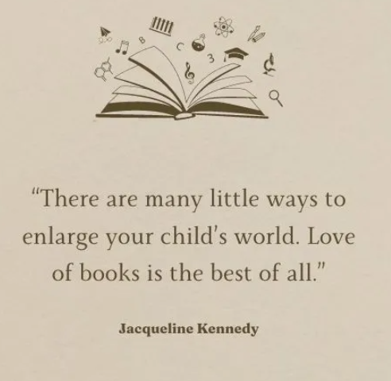
Reading Workshop (Years 2-6)
Miss Noonan

Slide 2
Aims of today’s session:
To outline the importance of reading in school and at home
Dispel some myths about reading
How we read
What we read – Manland’s Book Spines
To explain our approach to teaching reading at Manland
Reading lessons in Year 2 upwards
Share useful resource and guidance updates
Questions?

Slide 3
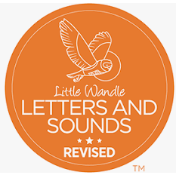
The phonics program we follow at Manland is ‘Little Wandle Letters
and Sounds’.
Children start this in Reception, continuing into Year 1, with a review at the start of Year 2.
Phonics starts the ‘reading engine’ – gets the word-reading motor going. Learning the sound/spelling correspondences enables children to decode.
In Year 1, children will have passed their phonics check and are all
successful decoders – but what next?
Phonics at Manland

Slide 4
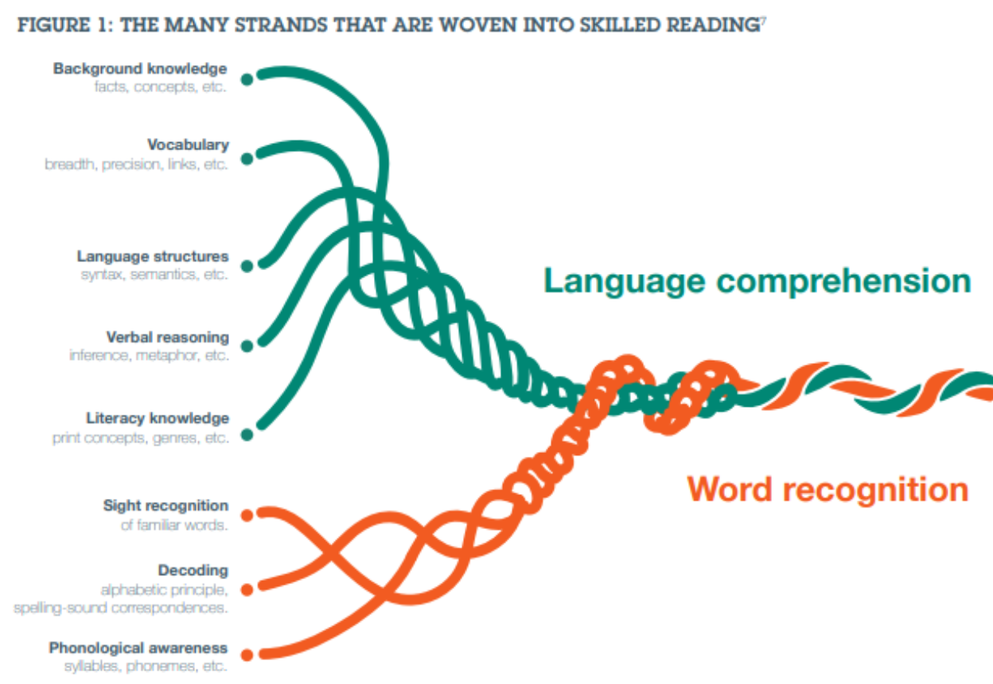
Scarborough’s
Reading Rope

Slide 5


Reading at Manland
Of the subjects taught in school, reading is the first amongst equals – all other subjects rely on it.
Excellence in any academic subject requires strong, deep reading – getting the ‘gist’ of something is not enough.

Slide 6
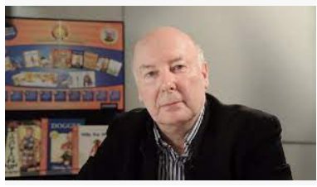
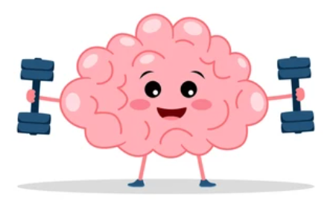
Reading and thinking deeply
Pie Corbett
In order for children to become strong, fluent readers, they should be able to talk deeply about what they’re reading.
What we read shapes how we think. Read deeply and slowly (loiter with the text), enables children to think deeply.
To infer, children need to understand the vocabulary, predict and summarise events.

Slide 7
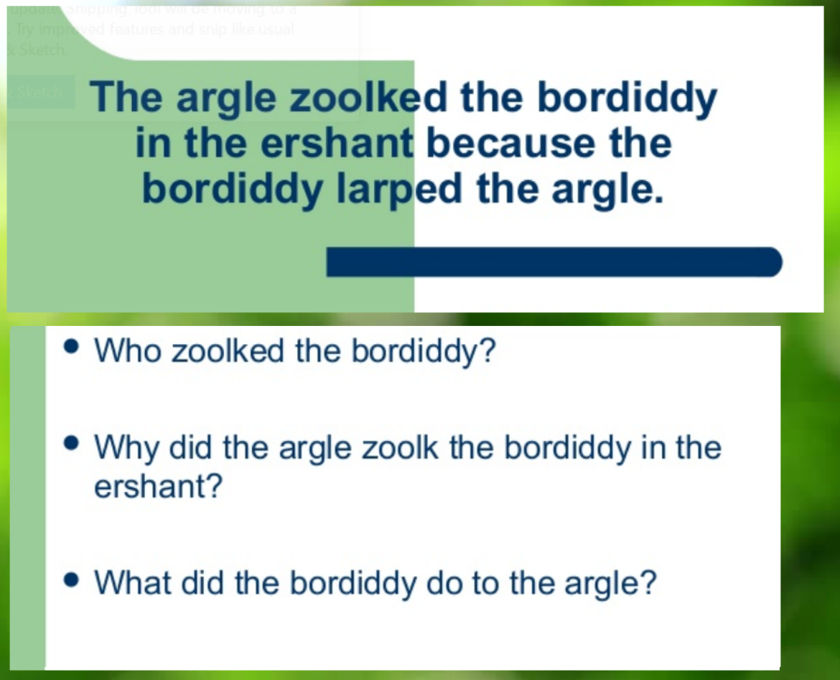
Developing fluent reading.
Myth 1: good word reading equals good comprehension

Slide 8
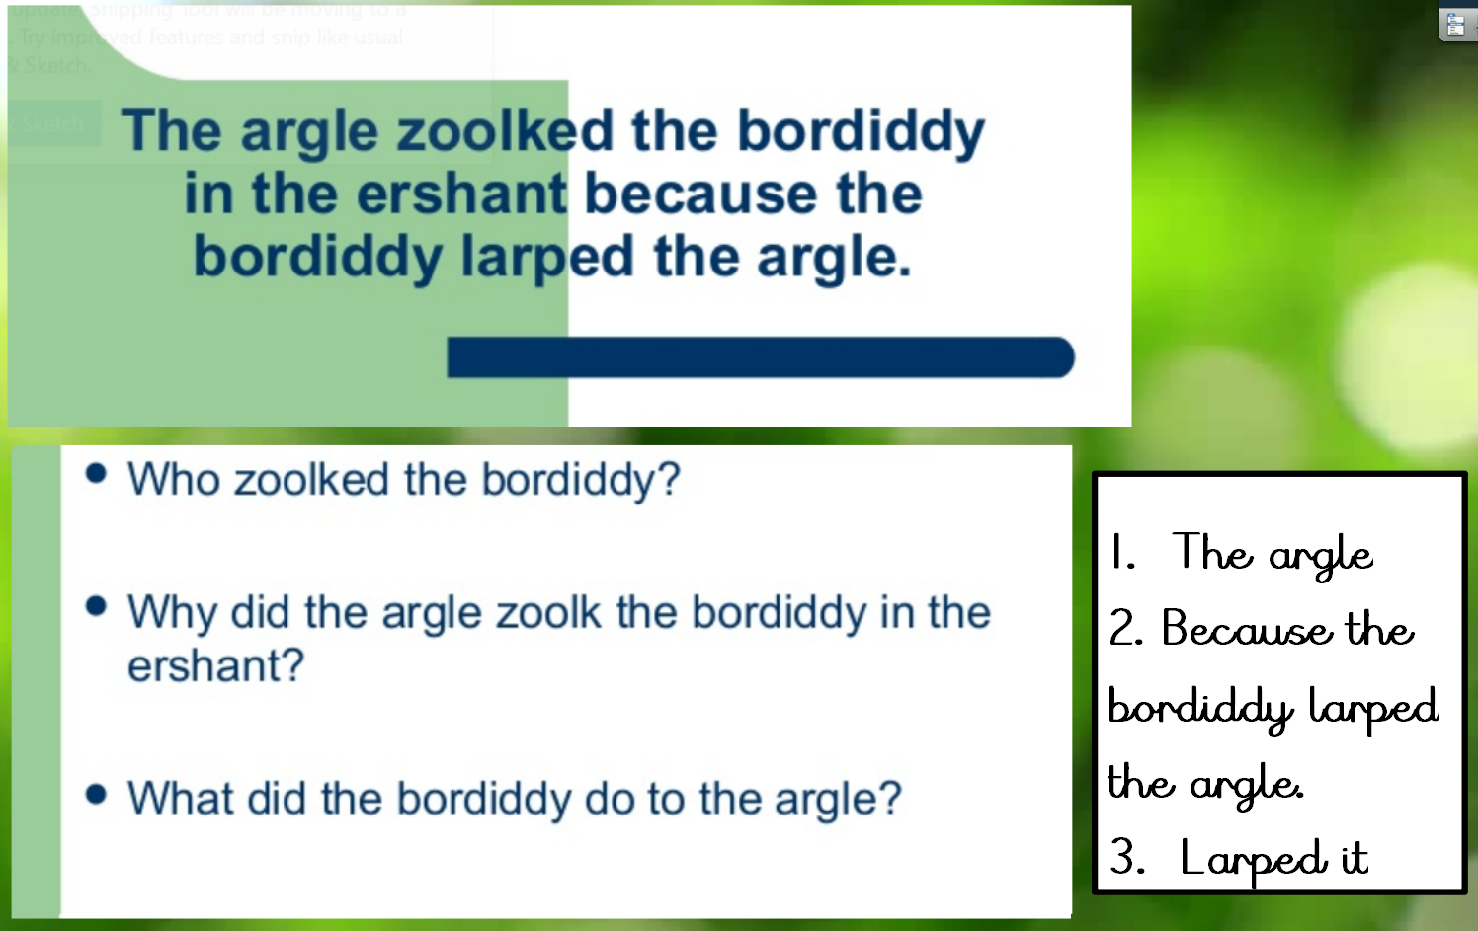

Slide 9
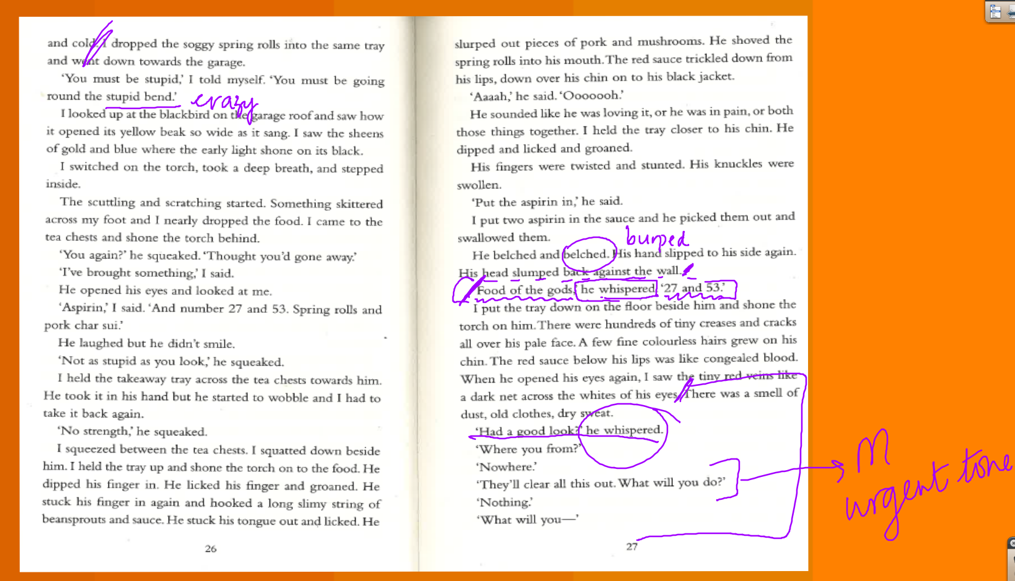
Myth 2 – adults modelling of oral reading alone improves fluency
Fluent reading has to be modelled in a metacognitive fashion.
As fluent readers, we need to make our choices clear and explain why we’ve made them.

Slide 10
B
Myth 3: silent independent reading improves fluency
In our Reading lessons, we are optimising opportunities for ALL to read.
Teacher modelled read
Teacher reads, children listen and enjoy the story. Teacher makes their choices of phrasing, pace and expression clear. This could mean circling which key words we’ll stress and why.
Shared read
In partners, children read the text to each other. Adults support listening partner to provide feedback when they get stuck. Then they swap (3 times per partner to build accuracy).
Choral read
We read the whole text aloud, together with teacher giving feedback on common misconceptions – building fluency and accuracy.

Slide 11
B
In our Reading lessons, we are optimising opportunities for ALL to read.
Echo read
Teacher models a sentence or phrase, children read the same sentence or phrase.
Choral read (again)
We read the whole text aloud, together again with teacher giving feedback on common misconceptions or what has improved – building accuracy.
Re-reading leads to improved accuracy and fluency.
Fluent reading sounds like a conversation.
This leads to automatic sight reading, freeing up thinking for understanding and
thinking deeply.
Myth 3: silent independent reading improves fluency

Slide 12
B
Archaic texts – those that use different words in unfamiliar sequences.
Non-linear time sequence – events that jump around in time.
Complexity of narrator – when multiple narrators tell the story.
Resistant texts – texts where the reader must assemble their own meaning using nuances, hints and clues (for example, in poetry).
Complexity of story – those that contain sub-plots and interwoven plots.
The Five Plagues
The ‘plagues’ refer to the difficulties faced by developing
readers tackling challenging texts.

Slide 13

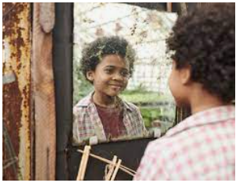
B
Manland’s Book Spines
A good book spine acts as a window and a mirror.
A window to other worlds but acts as a mirror where children can also see themselves (characters like them) reflected in books too.
Our book spines have:
Diverse representation
Relevant social issues
Big ethical questions
Moral dilemmas

Slide 14
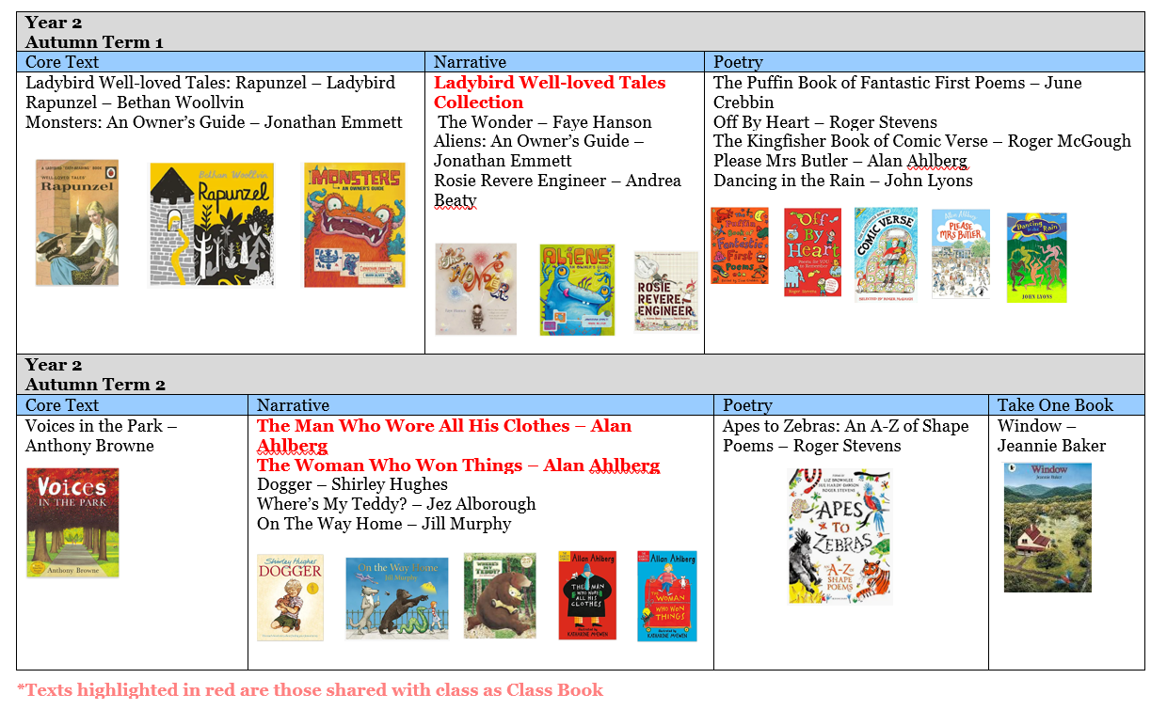
B
Manland’s Book Spines

Slide 15
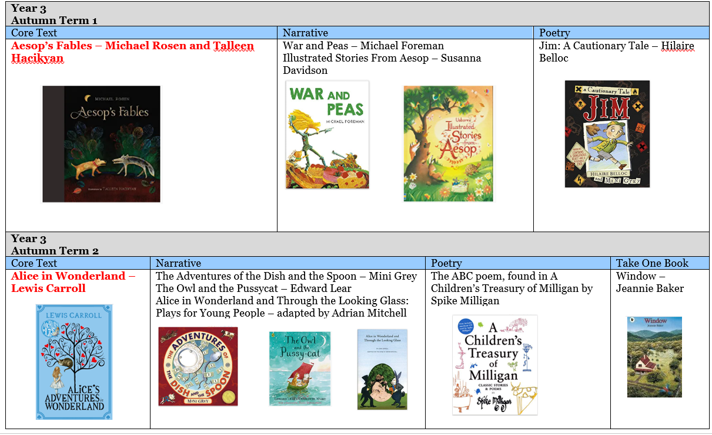
B
Manland’s Book Spines

Slide 16
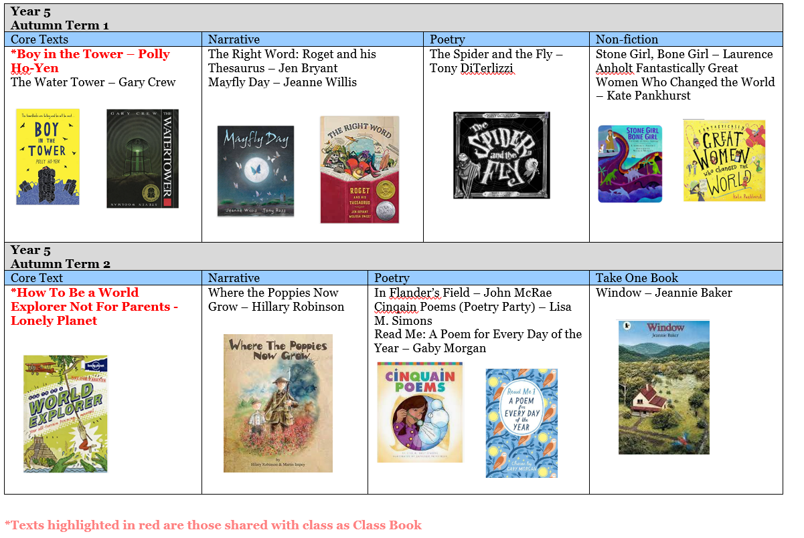
B
Manland’s Book Spines

Slide 17
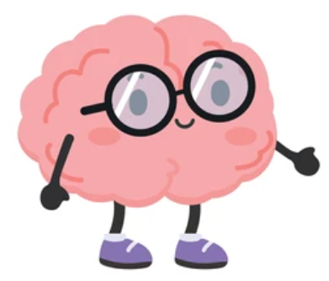


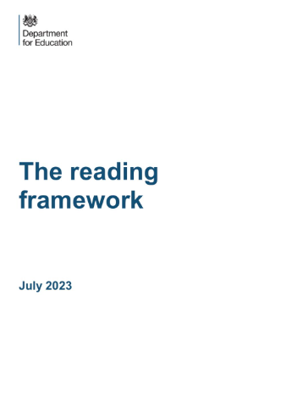

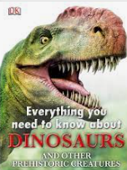
B
Hi-lo books
These are books that provide high-interest, but low-challenge.
It is thought that these books are not only establishing reading habits, but lead on to more challenging books later on.
If children enjoy what they’re reading, they’ll read it for
longer.

Slide 18
B

Slide 19
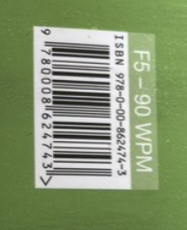
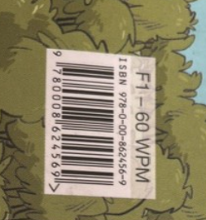
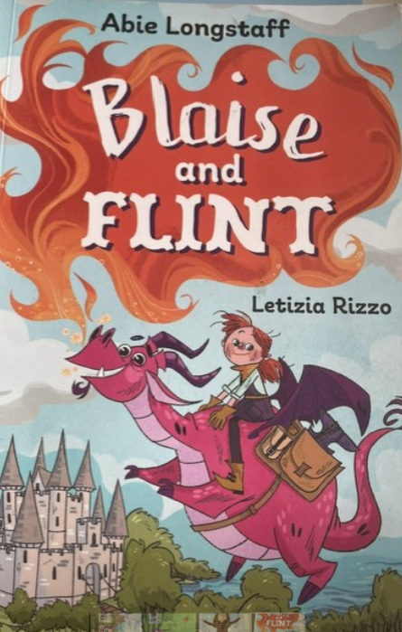
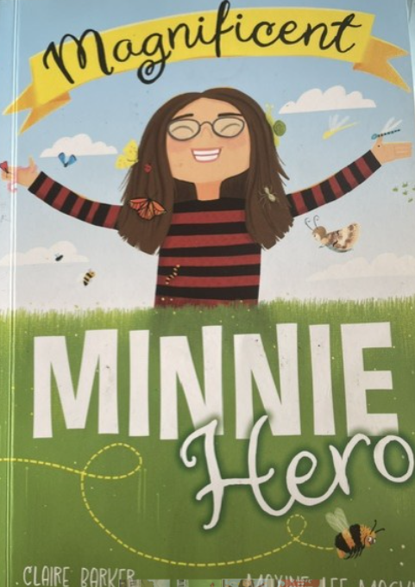
B

Slide 20
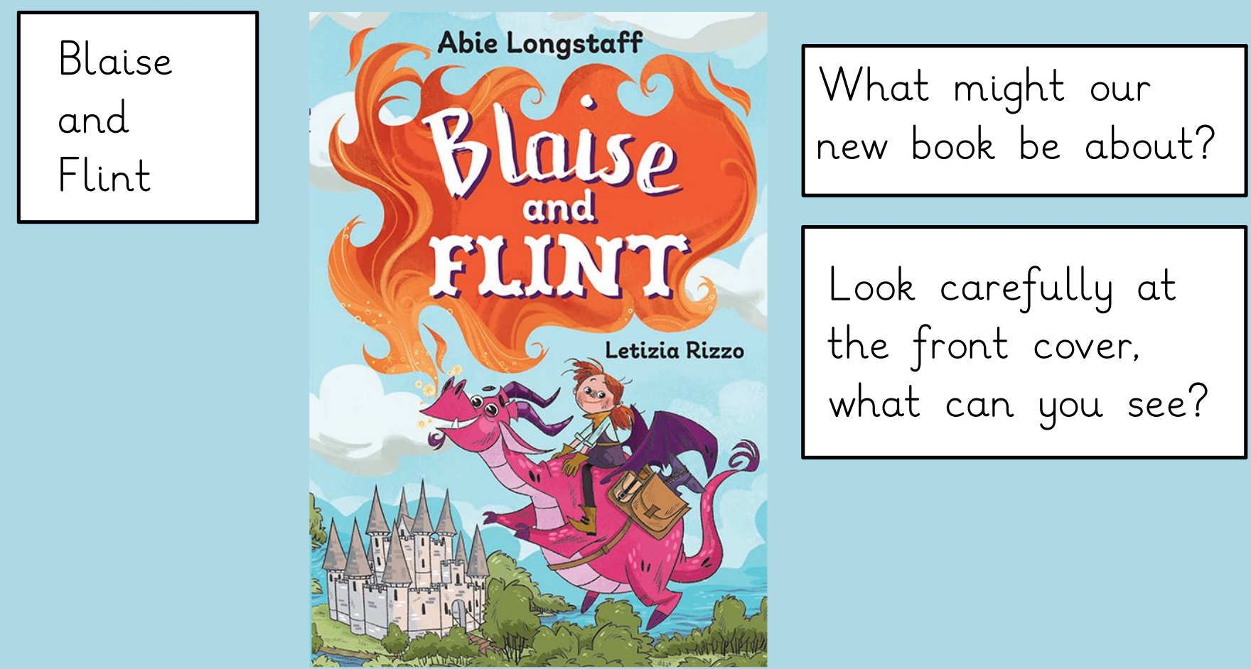
B

Slide 21
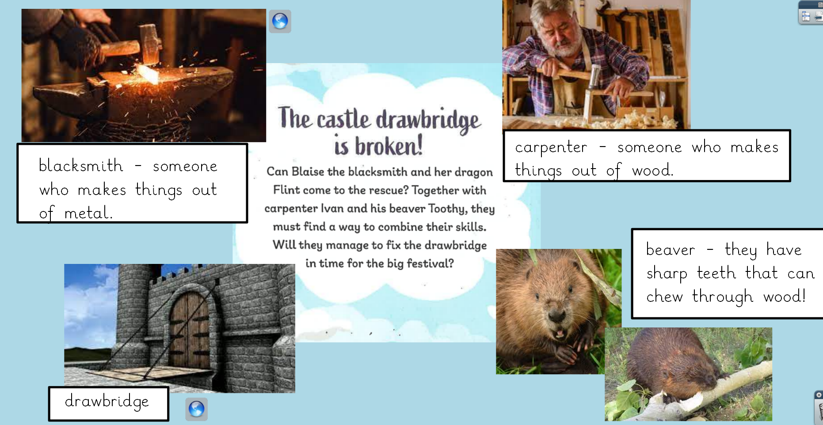

Slide 22
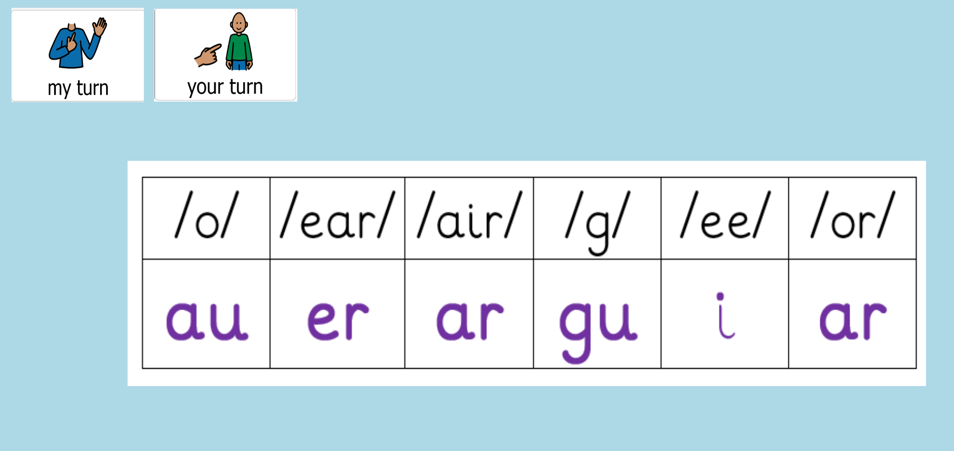
B

Slide 23
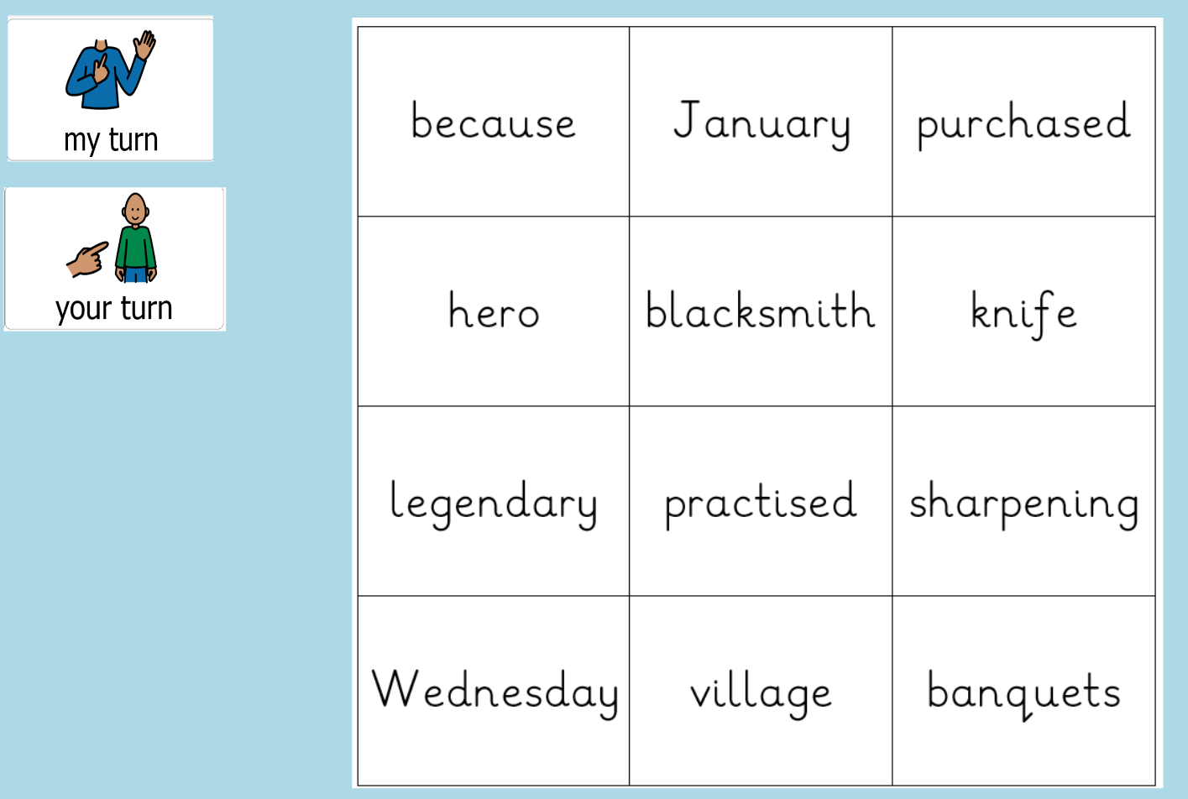
B

Slide 24
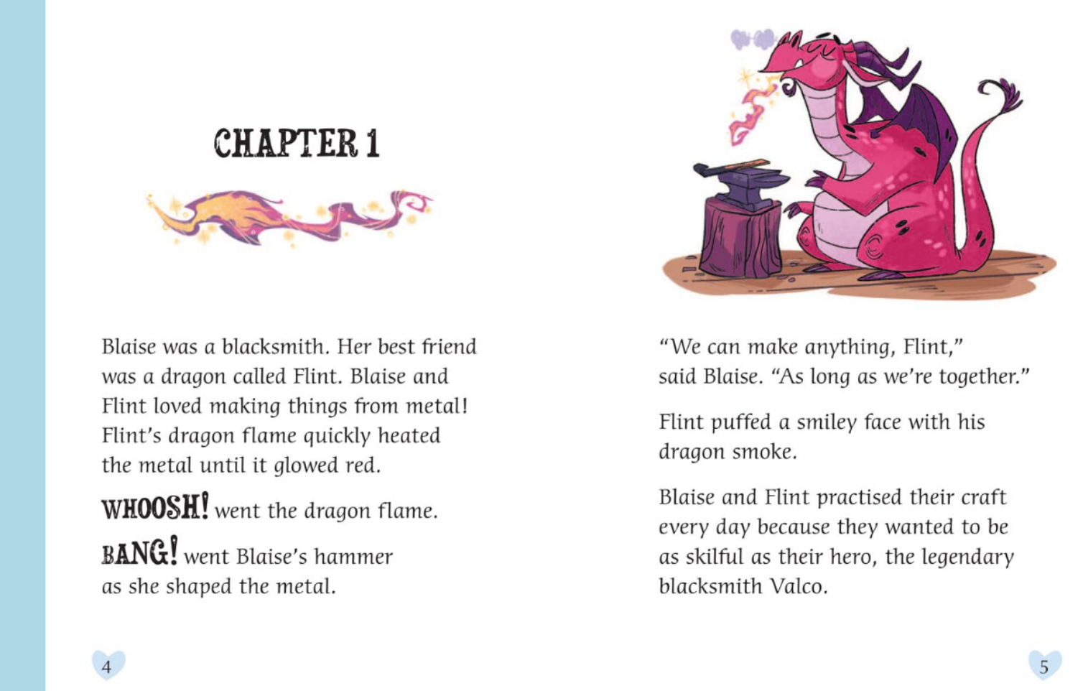

Slide 25
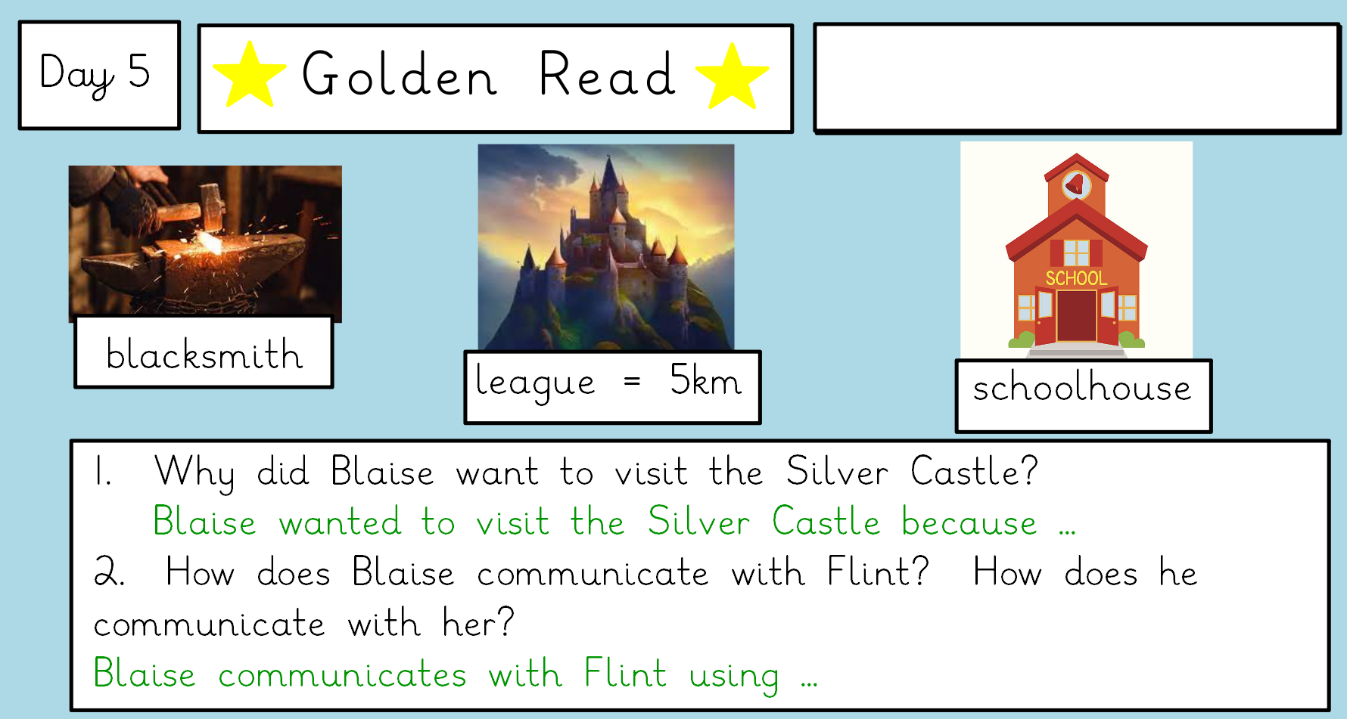

Slide 26
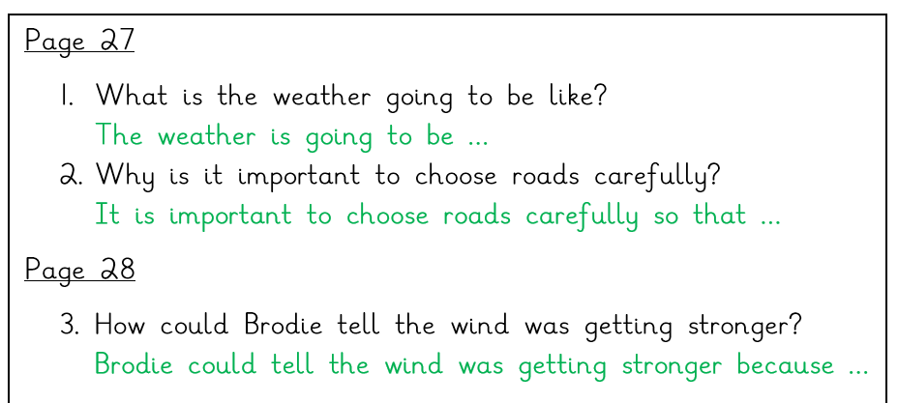
Whole-class questions
Page reference
Answer stem

Slide 27
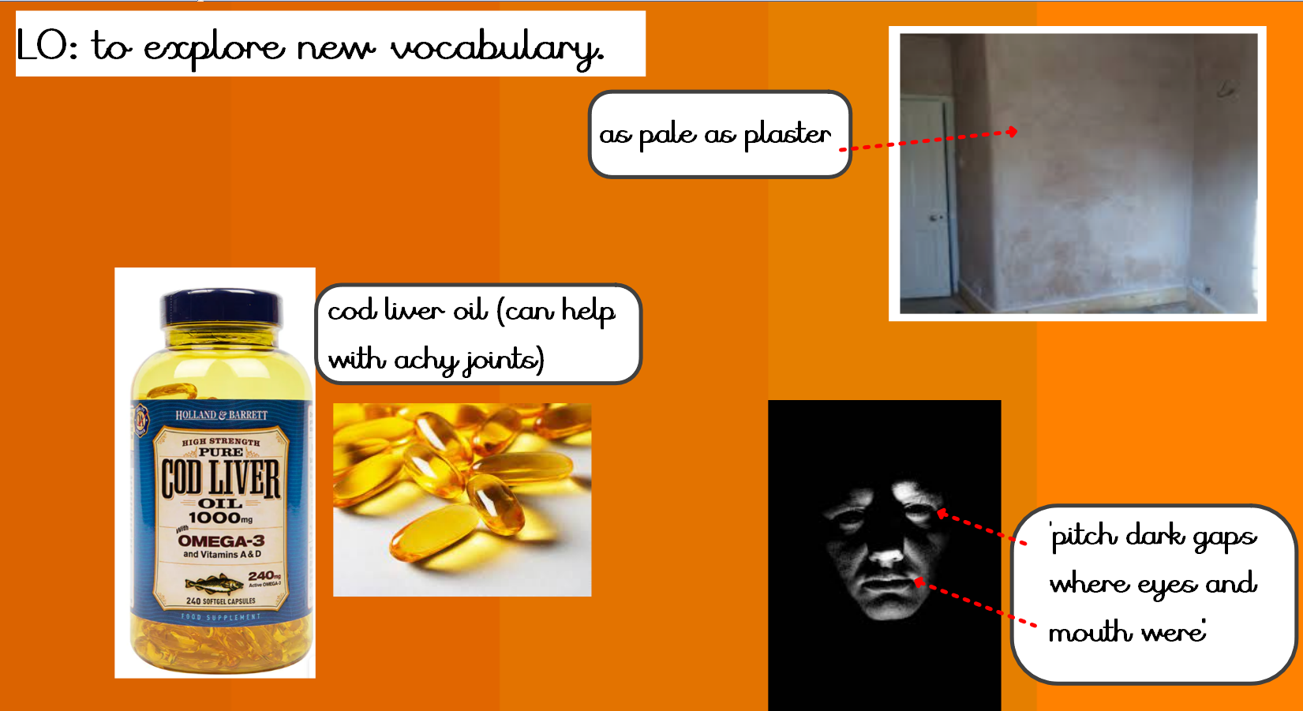

Slide 28
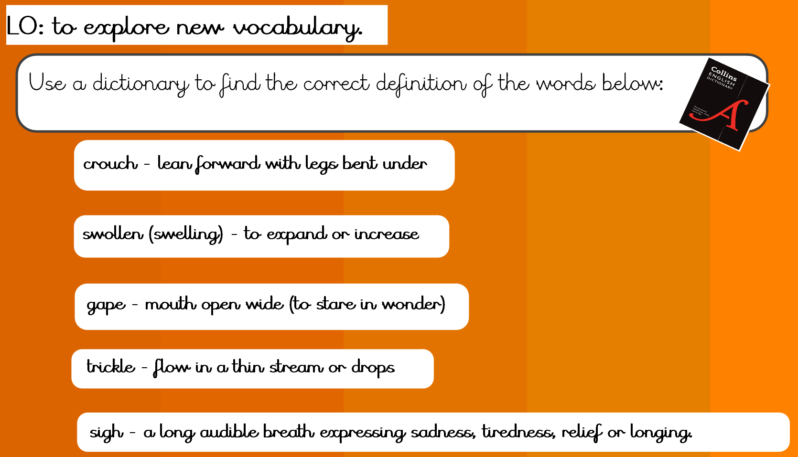

Slide 29
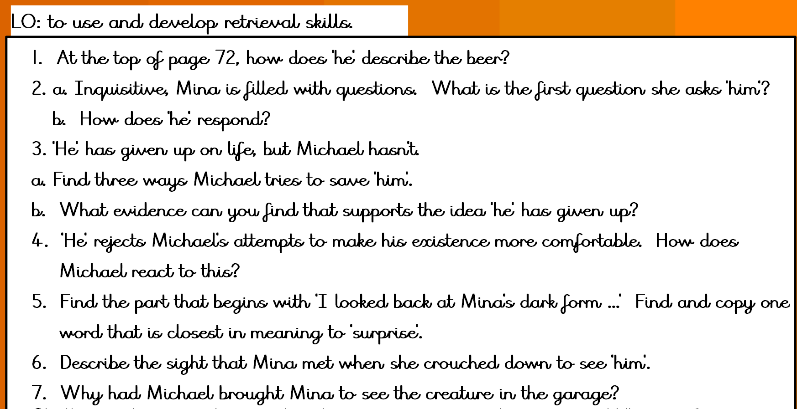

Slide 30
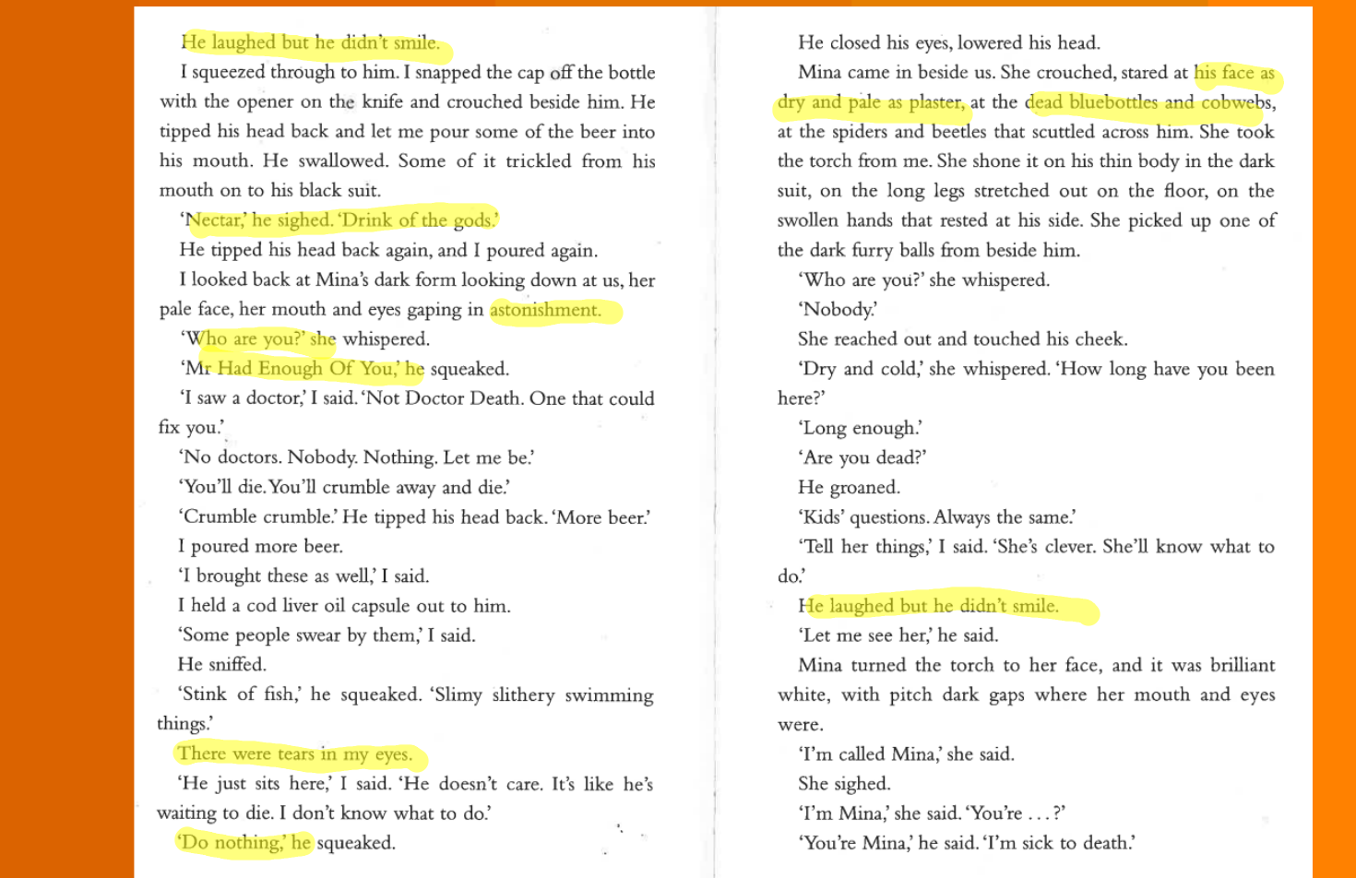

Slide 31
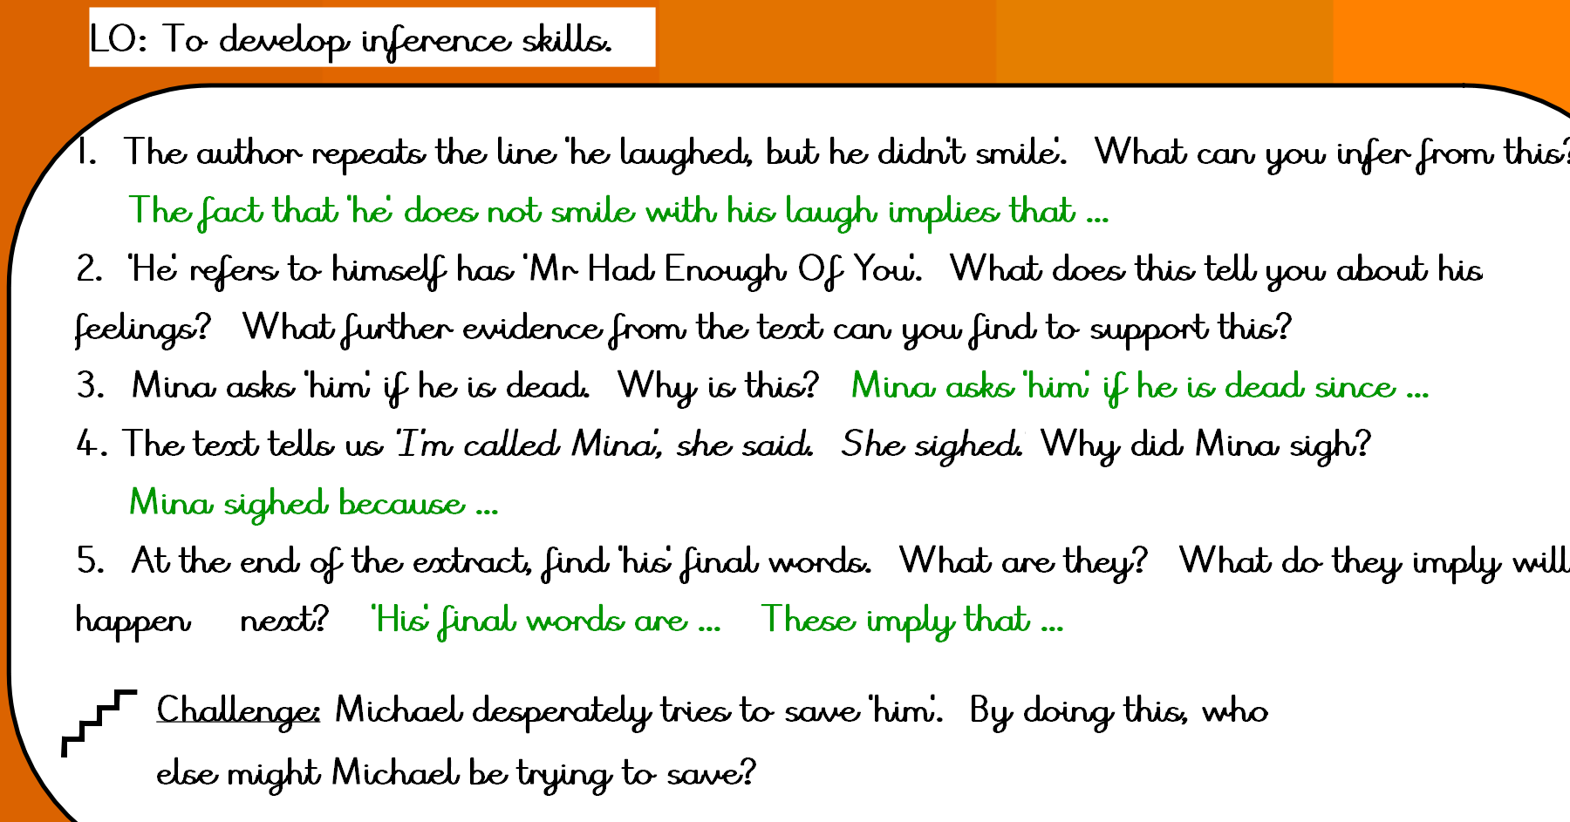
Notes:
Day 2 focuses on quick retrieval. Children do not have to answer these in full sentences.

Slide 32
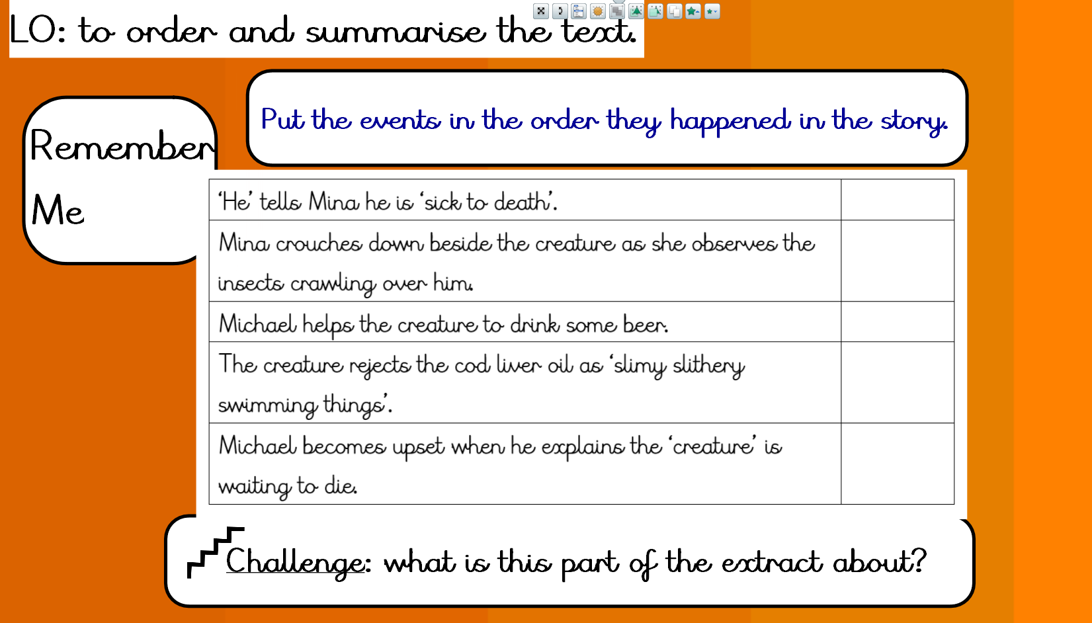

Slide 33
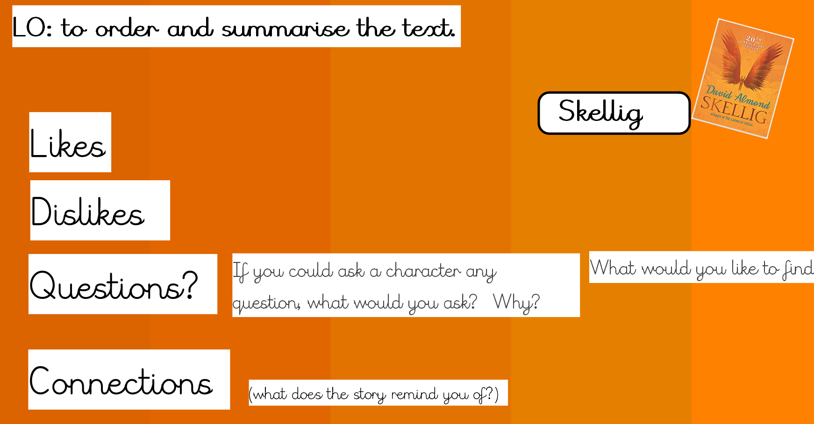

Slide 34

Myth 3: silent independent reading improves fluency
The only way we can be 100% sure that children are reading, is to hear them read aloud. In class, we monitor:
How long has the child had their personal reading book?
Do they seem to making progress through their book?
Are they turning pages, or simply holding the book?
Can they tell you about the plot or characters?
Can they explain what their favourite part is or what they dislike?

Slide 35
Reading at Manland
We must ensure fluency to maximise thinking deeply (comprehension)
Fluency = automaticity in word recognition + reading expressiveness
This happens through guided repetition
Reading quickly = fake fluency
It’s not just the words , but the way we read the words
Good readers read in phrases, weaker readers read word by word

Slide 36
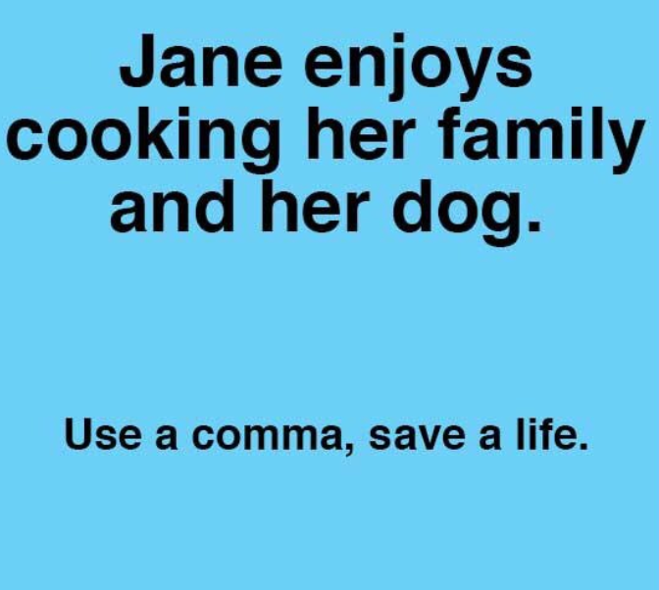
Reading at Manland
Good readers read in phrases, weaker readers read word by word

Slide 37
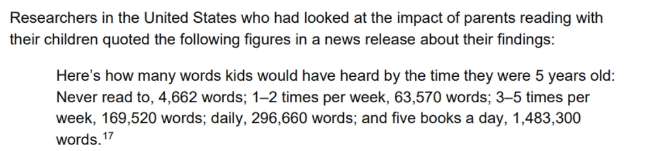
When children are engaged early on with books,
this prepares them for becoming committed and enthusiastic readers.
Children learn to focus and share the enjoyment of the story
They learn how stories start and finish, how plots unravel and are resolved and that books can transport them elsewhere.
Book-related talk introduces children to language they might not hear in ordinary conversation.

Slide 38


Reading at home
Younger readers – choose a picture book
Older readers – a chapter, page, paragraph, group of sentences
Read to them, 2-3 times
Read with them, 2-3 times
Child reads to you 2-3 times

Slide 39
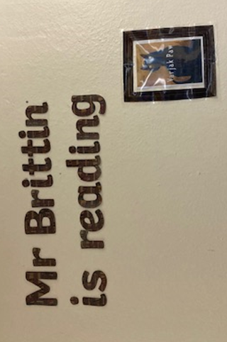
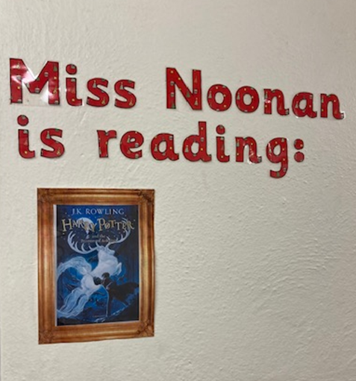
Reading at Manland
“We are teachers who read, and readers who teach”
In terms of influencing pupils, teachers are the best promoters. Pupils are willing to trust the judgement of a teacher who says, “I think you’ll enjoy this one”. Children feel that their teacher knows them well enough to care about the likes and dislikes.

Slide 40
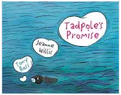
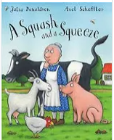

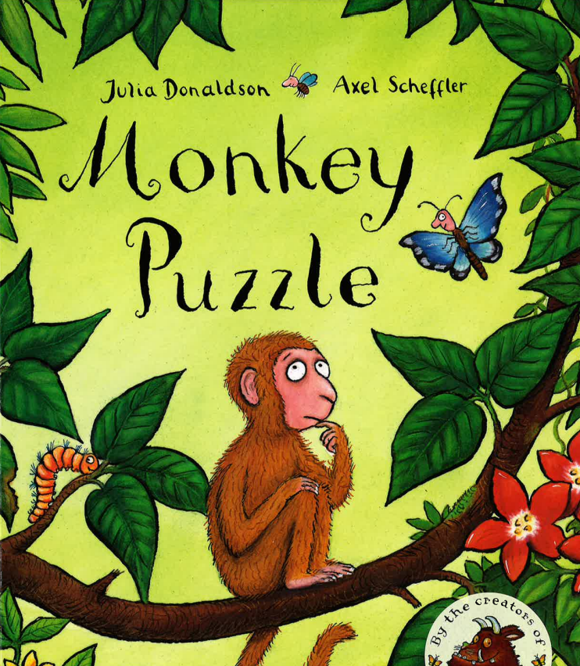
Thriving on repetition
It’s not just the range of stories children listen to that matters.
On each re-reading, their familiarity with the story deepens, and with that comes greater emotional engagement.
When children ask for a story to be re-read, they’re asking for another chance to explore the language, the characters and the feelings, and to relive the emotions they felt on that first reading. There is comfort in knowing what is coming next. They wait for the favourite bits, ready to join in or be scared, safe in the knowledge that it all works out fine in the end. Their attachment to the story equips them to retell it and, when they have learnt to read, encourages them to read it for themselves.

Slide 41

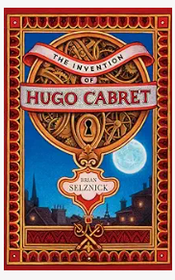


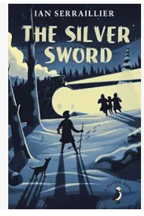

Reading at home
Inspiring boys to read …

Slide 42
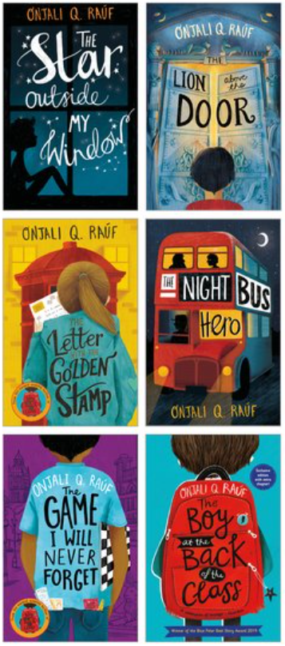
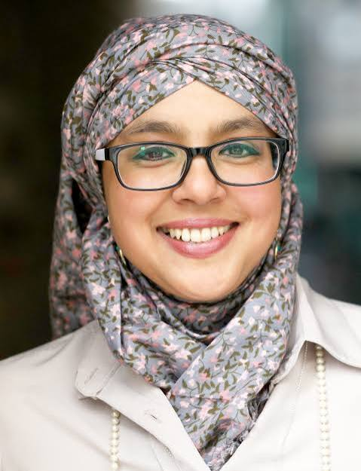
Reading at Manland
Lost WW2 heroes
Selective mutism
Being a young carer
Bullying, homelessness
Living with elderly relatives who have dementia
Onjali Q. Rauf
Child refugees, taking a moral stance

Slide 43
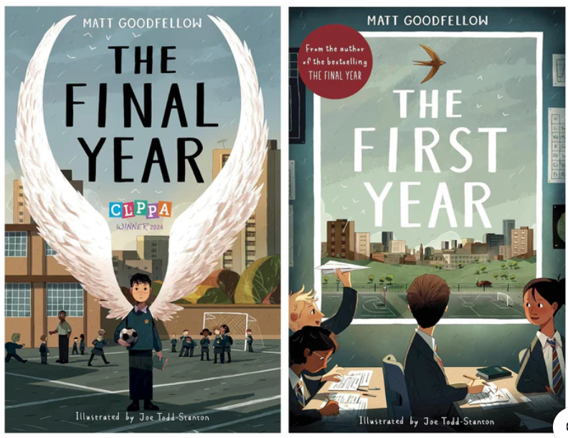
“We are teachers who read, and readers who teach”

Slide 44
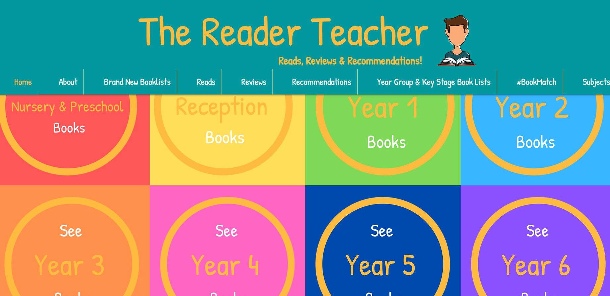
The Reader Teacher
The Reader Teacher | Children's Books | Reads, Reviews & Recommendations

Slide 45


